Slide 1
LightGBM (Light Gradient Boosting)
-by sharan

Slide 2
LightGBM (Light Gradient Boosting )
Definition: LightGBM (Light Gradient Boosting Machine) is a distributed and high-performance GBDT framework developed by Microsoft.
Primary Focus: Speed and low memory consumption, especially for handling massive datasets.
Two Core Innovations: LightGBM achieves its speed through two novel techniques:
  GOSS (Gradient-based One-Side Sampling)
  EFB (Exclusive Feature Bundling)

Slide 3
LIGHTGBM TREE GROWTH AND SPEED
Leaf-wise (Best-Fit) Tree Growth: Unlike the level-wise approach of XGBoost, LightGBM grows the tree leaf-wise.It always chooses the leaf that yields the maximum reduction in loss to split next.
Advantage: Can often achieve lower error faster than level-wise growth.
Drawback: Can lead to very deep, asymmetric trees and potentially overfitting on smaller datasets. (Controlled by the max_depth parameter).
Histogram-Based Algorithm: The core speed-up.Instead of scanning all possible split points for a continuous feature (pre-sorted algorithm used by others), it bins continuous values into discrete bins.Splitting is done on these discrete bins. This drastically reduces the number of comparisons and significantly lowers the memory footprint

Slide 4
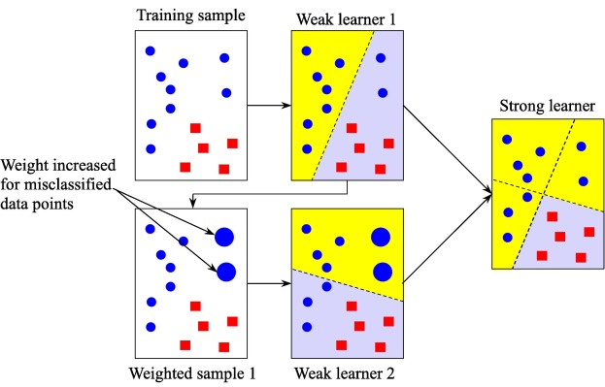

Slide 5
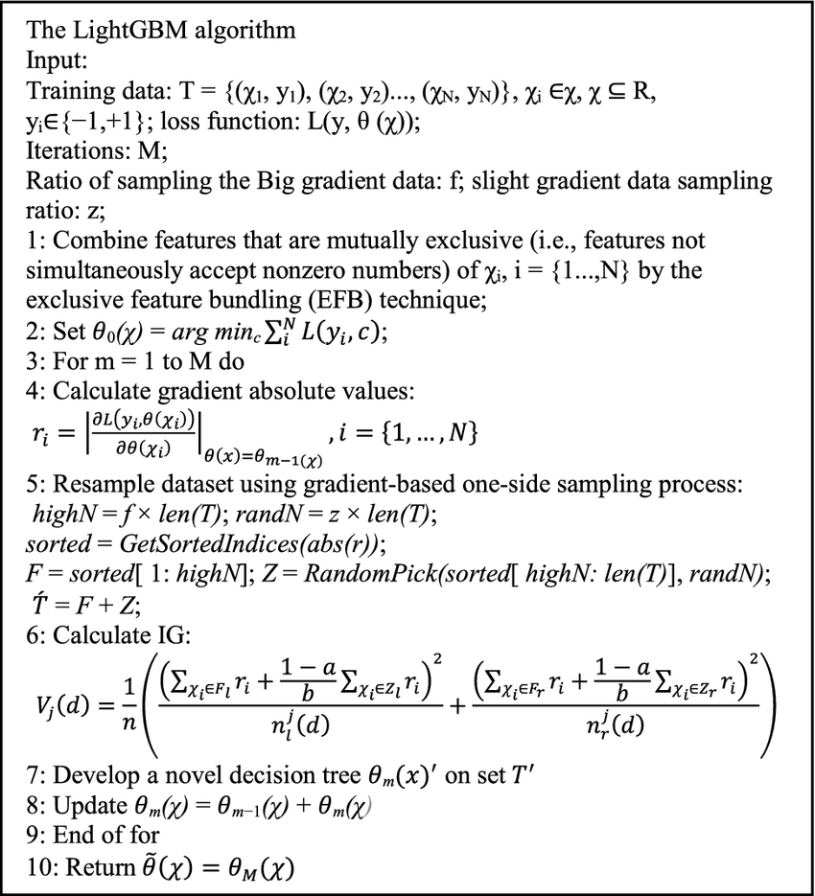

Slide 6
LightGBM Performance and Use Cases
Speed Champion: LightGBM is typically several times faster than XGBoost, making it the top choice for massive datasets.
Memory Efficiency: The histogram-based approach and EFB dramatically reduce memory usage.
Use Cases:
  Ideal for Big Data problems where training time is a constraint.
  Applications involving massive numbers of features (due to EFB).
  Scenarios where low latency prediction is required.
Recommendation: Use caution on small datasets where its leaf-wise growth may easily lead to overfitting.

Slide 7
CONCLUTION
LightGBM is a high-performance, distributed GBDT framework that revolutionized the field by prioritizing efficiency and speed over all else. Developed by Microsoft, it addresses the computational bottlenecks of traditional boosting algorithms, making machine learning feasible on very large, high-dimensional datasets.
Key Strengths & Innovations
Blazing Fast Training: Achieved through the Histogram-based Algorithm (binning continuous features) and GOSS (Gradient-based One-Side Sampling), which intelligently samples hard-to-learn examples.
Low Resource Footprint: The histogram and EFB (Exclusive Feature Bundling) techniques dramatically reduce memory usage and communication costs, making it ideal for memory-constrained environments.
Superior Scaling: Its Leaf-wise Tree Growth strategy (best-fit) often leads to faster loss reduction and higher accuracy compared to level-wise growth, especially on big data.
Native Categorical Support: Simplifies the preprocessing pipeline and enhances performance for datasets with numerous categorical features.

